Slide 1
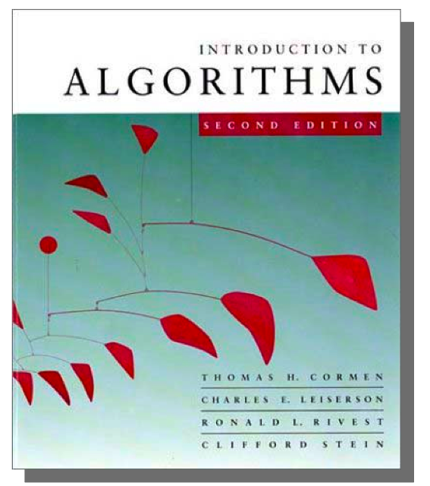
CSE 780: Analysis of Algorithms
Instructor : Prof. Yusu Wang
TA :
Time : MW 11:30 am – 12:48 pm
Room : DL0357
CSE 780 Algorithms

Slide 2
Course Information
Course webpage
http://www.cse.ohio-state.edu/~yusu/courses/780
Office hours
  MW: 1:00 – 2:00pm
Grading policy
  Homework: 30%, Midterm: 30%, Final: 40%
Exams:
  Mid: April 25th (Wed), 11:30am – 12:50 pm (in class)
  Final: June 7 (Thu), 11:30am – 1:18pm
    This is the time scheduled by the University Registra
CSE 780 Algorithms

Slide 3
More Information
Textbook
  Introduction to Algorithms
  by Cormen, Leiserson, Rivest and Stein
    (third edition)
Others
  Algorithm Design
    By Kleinburg and Tardos
  Algorithms
    By DasGupta, Papadamitriou and Vazirani
CSE 780 Algorithms

Slide 4
Introduction
What is an algorithm?
Our goal?
  Step by step strategy to solve problems correctly
  Understand what good algorithms are
    Performance is key
    Provide a language to measure/analyze performance
  Study how to define good algorithms
CSE 780 Algorithms

Slide 5
Description
Analysis:
  Asymptotic complexity
  Analyzing techniques
Paradigms :
  Divide and conquer, Greedy algorithm, Dynamic programming, etc
Data structures:
  Search trees, union-find data structure, etc
Designing:
  Graph algorithms, geometric algorithms, etc
CSE 780 Algorithms

Slide 6
Tentative Schedule
Introduction to algorithms (CLRS: Ch. 1 – 4, 6, 7)
  Solving recurrences to analyze algorithms
  Divide-and-conquer framework
Searching and order statistics (CLRS: Ch. 7, 8.1, 9)
  Randomized analysis
Dynamic programming and Greedy paradigms (CLRS: Ch. 15, 16)
Graph representation and basic algorithms (CLRS: Ch. 22)
Amortized analysis and union-find data structure (CLRS: Ch. 17)
Advanced graph algorithms (CLRS: Ch. 23 – 25)
Advanced topics in algorithms (TBA)
CSE 780 Algorithms

Slide 7
Today
Introduction to algorithm analysis
  Overlap with CSE 680.
  Will go fast in the first few lectures --- the goal is more for reviewing.
CSE 780 Algorithms

Slide 8
Sorting problem
Input:
Output: permutation of A that is sorted
A = < , , …. >
a
a
a
1
2
n
Example:
  Input: < 3, 11, 6, 4, 2, 7, 9 >
  Output: < 2, 3, 4, 6, 7, 9, 11 >
CSE 780 Algorithms

Slide 9
Insertion Sort
1
i
i+1
n
3, 11, 6, 4, 2, 7, 9
3, 6, 11, 4, 2, 7, 9
3, 4, 6, 11, 2, 7, 9
2, 3, 4, 6, 11, 7, 9
CSE 780 Algorithms

Slide 10
Pseudo-code
InsertionSort(A, n)
for i = 2 to n do
key = A[i]
j = i - 1
while j > 0 and A[j] > key do
A[j+1] = A[j]
j = j - 1
A[j+1] = key
CSE 780 Algorithms

Slide 11
Analysis
Termination
Correctness
  beginning of for-loop: if A[1.. i] sorted, then
  end of for-loop: A[1.. i+1] sorted.
Efficiency: time/space
  Depends on input size n
  Space: roughly n
CSE 780 Algorithms

Slide 12
Running Time
Depends on input size
Depends on particular input
  Best case
  Worst case
First Idea:
Make it a function of n : T(n)
CSE 780 Algorithms

Slide 13
Running Time
Worst case
  T(n) = max time of algorithm on any input of size n
Average case
  T(n) = expected time of algorithm over all possible inputs of size n
  Need a statistical distribution model for input
    E.g, uniform distribution
Best case
CSE 780 Algorithms

Slide 14
Insertion Sort
InsertionSort(A, n)
for i = 2 to n do
key = A[i]
j = i - 1
while j > 0 and A[j] > key do
A[j+1] = A[j]
j = j - 1
A[j+1] = key
c
1
c
2
n
2
T(n) ≤ Σ ( + i ) = + n +
c
c
c
n
c
c
1
2
3
4
5
i=2
CSE 780 Algorithms

Slide 15
Asymptotic Complexity
Why shall we care about constants and lower order terms?
Should focus on the relative growth w.r.t. n
  Especially when n becomes large !
Second Idea:
Ignore all constants and lower order terms
--- Asymptotic time complexity
CSE 780 Algorithms

Slide 16
Big O Notation
O(g(n)) = { f(n) | ∃ c > 0, and n₀ , so that
0 ≤ f(n) ≤ cg(n) for all n ≥ n₀ }
f(n) = O(g(n)) means f(n) ∈ O(g(n)) (i.e, at most)
f(n)
lim ≤ c
n→∞
g(n)
Examples
  lg n = O ( n ) ?
  6 n²+ 500 n = O (n²) ?
  3^{n} = O(2^{n}) ?
CSE 780 Algorithms

Slide 17
Omega Ω Notation
n
Ω (g(n)) = { f(n) | ∃ c > 0, and , so that
0 ≤ cg(n) ≤ f(n) for all n ≥ }
f(n) = Ω (g(n)) means f(n) ∈ Ω (g(n)) (i.e, at least)
0
n
0
f(n)
lim ≥ c
n→∞
g(n)
Examples
  lg n = Ω ( lg lg n ) ?
  6 + 500 n = Ω ( ) ?
  = Ω ( ) ?
n
2
n
2
n
n
3
2
CSE 780 Algorithms

Slide 18
Theta Θ Notation
Combine lower and upper bound
  f(n)=Θ(g(n)) means f(n)=O(g(n)) and f(n) = Ω(g(n))
Means tight: of the same order
Θ(g(n)) = { f(n) | ∃ a,b > 0, and n₀ , so that 0 ≤ ag(n) ≤ f(n) ≤ bg(n) for all n ≥ n₀}
  f(n)=Θ(g(n)) means g(n)=Θ(f(n)) ?
Insertion sort:
  Worst case running time is Θ (n²).
CSE 780 Algorithms

Slide 19
Examples
lg n and lg² n
log₂ n and log₁₀ n
n^{0.0001} and lg n
n² + nlg n and 10n²
CSE 780 Algorithms

Slide 20
Notes on Asymptotic Complexity
Provide a unified language to measure the performance of algorithms
  Give us intuitive idea how fast we shall expect the alg.
  Can now compare various algorithms for the same problem
Constants hidden!
  O( n ), n lg lg n
T(n) = n² + O (n) means T(n) = n²+ h(n), and h(n) = O(n)
Not any two functions have such relations!
  It is sometimes convenient to think of big-O and big-Ω as ≤ and ≥ , however, one should realize the differences.
  Although these relations are transitive!
CSE 780 Algorithms

Slide 21
Pitfalls
OK
O(n) + O(n) = O(n)
T(n) = n + Σ O(n)
= n + O(n)
k
?
i = 1
k should not depend on n !
It can be an arbitrarily large constant …
CSE 780 Algorithms

Slide 22
Yet Another Notation
Small o notation:
f(n) = o(g(n)) means f(n) = O(g(n)) but f(n) ≠ Θ(g(n))
f(n)
lim = 0
n→∞
g(n)
Examples:
  Is n - lg n = o(n) ?
  Is n = o (n lg n / lg lg n) ?
CSE 780 Algorithms

Slide 23
Summary
Algorithms are useful
Example: sorting problem
  Insertion sort
Asymptotic complexity
  Focus on the growth of complexity w.r.t input size
CSE 780 Algorithms

